Slide 1
Mobile control and simulation
Student: Rustemova Aynura Matricola: 234277

Slide 2
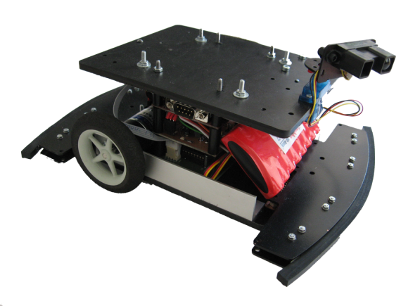
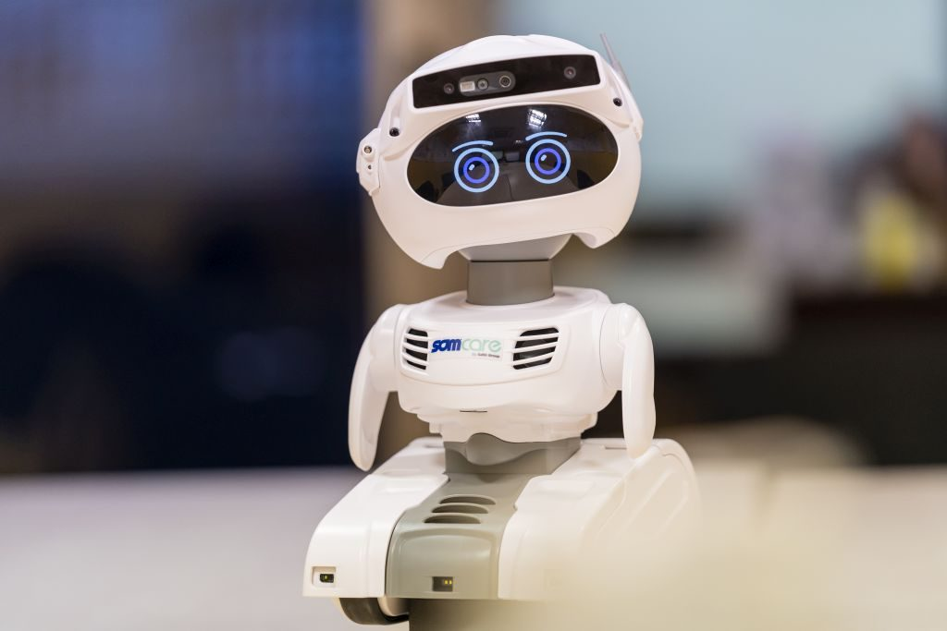
introduction
A mobile robot is a machine controlled by software that use sensors and other technology to identify its surroundings and move around its environment.
The main difference between mobile robots and fixed robots is that one can move and another cannot. Fixed robots are generally used for repetitive tasks where accuracy and speed are important. They are often the workhorses of many manufacturing plants.
Mobile robots are generally used for logistical processes to help make warehouse distribution faster and more efficient. Mobile robots are also useful for reaching places that are dangerous or inaccessible to human workers.

Slide 3
The main problems of mobile robotics
Where am I? It is Positioning problem in some cases mapping problem too, which can be solved using Sensor fusion based methods or Simultaneous Localization And Mapping (SLAM)
Where should I go? It is a Dynamic trajectory planning task where the robot path is dynamically updated depending on the environment status, the defined target/goal, the obstacles status
How can I move? It is a Control task where the robot actuators inputs have to be computed so that to ensure, trajectory tracking, posture regulation, constraints fulfilment

Slide 4

Control loop
Planner
Controller
Mobile robot
Environment
Sensors
TASK
$$ս$$

Slide 5
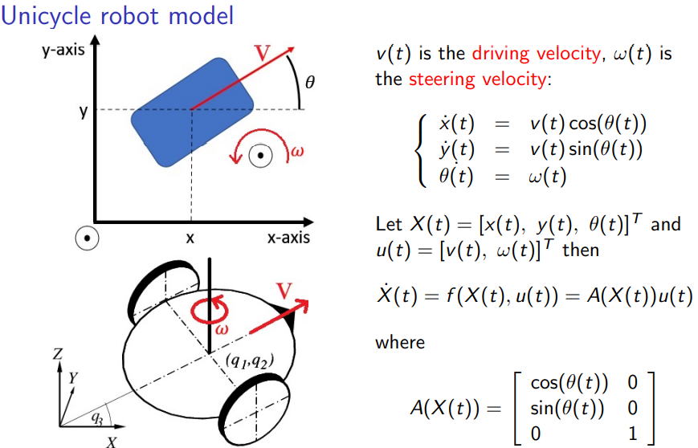

Slide 6
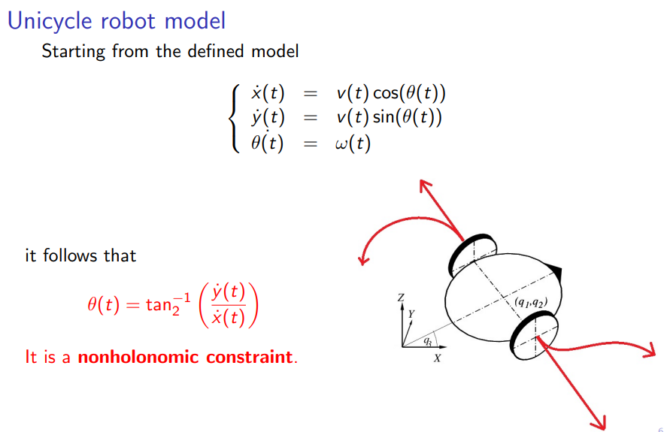

Slide 7
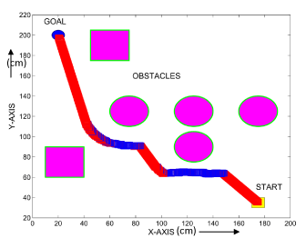
Path planning
Where should I go?
Task: from a given Starting position, reach a given Goal position, avoiding the obstacles in the environment.
To simplify the task, static obstacles, fixed environment assets, fixed goal, a-priori known starting position, a-priori known obstacles positions, no attitude are considered.

Slide 8
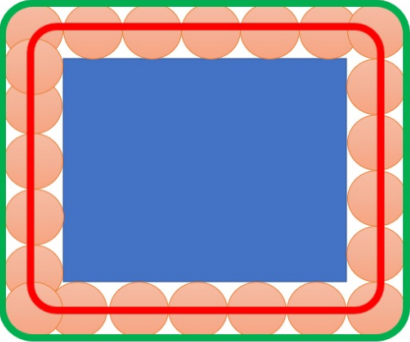
Obstacles management
Since the obstacles may have different shapes, it is advantageous to circumscribe the obstacle shape with a known shape.
Considering point based robot in simulations can lead to clashes in real scenario because the robot has a size greater than 0. The solution is to enlarge the obstacles so as to include robot size too, but paying with reduction of obstacle free region.
Blue rectangle is real robot
If point-based robot goes along red line,
no clashes occur
Green line for the safety

Slide 9
Path planning: Artificial Potential Fields
Artificial Potential Fields is one of the most fundamental and traditional algorithms used to design the reference trajectory for the robot.
The main idea is to convert the path planning problem into another one, which can be solved applying known methodologies.
The key ingredient is artificial potential field, which is placed on goal and obstacle positions. In fact, attractive potential field is placed on goal and repulsive one on the obstacles, so that robot can reach the target like a rolling ball on a sloped plane with obstacles.
The major drawback of this method is local minimum, which means the robot can stop in some point not reaching the goal. However, this problem can be handled by utilizing vortex method or changing the initial position.

Slide 10
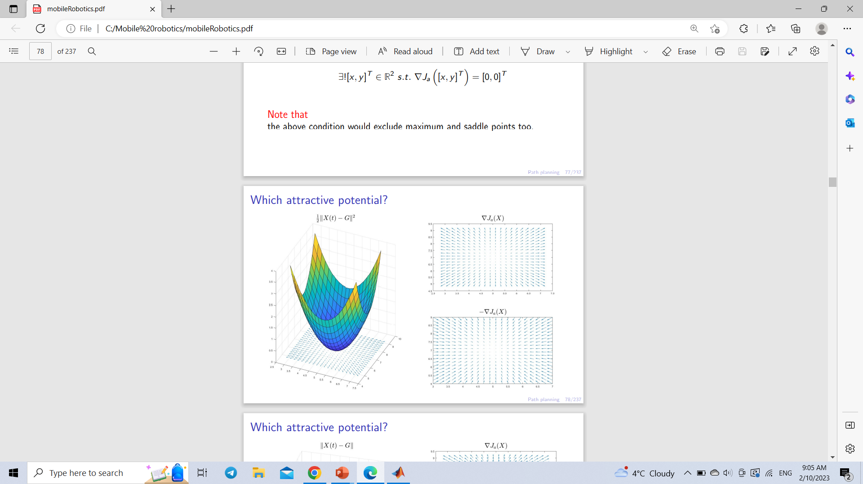
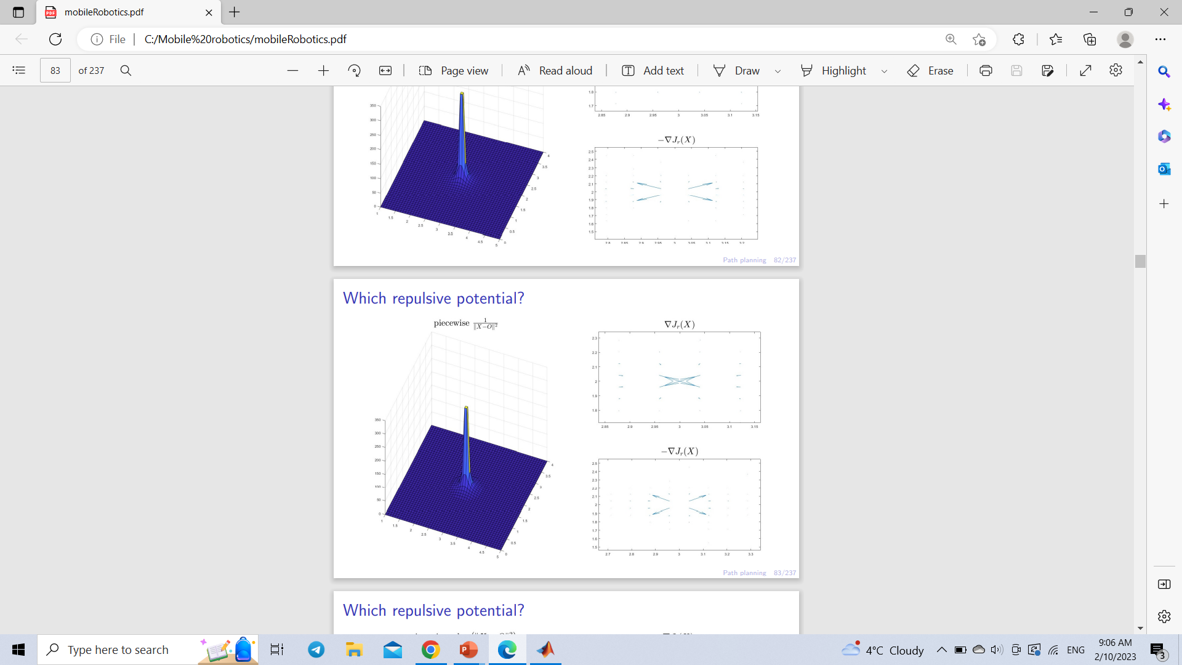
Artificial potential fields
The attractive potential should satisfy the following requirements:
it must have a global minimum on the goal position
usually it should have a unique minimum
The repulsive potential should satisfy the following requirements:
It should have ∞ on the boundaries of the obstacle.
The more robot is far from obstacle the more value of repulsive
potential should decrease.
The repulsive potential can be defined with piecewise function so that the effect of repulsion is considered only in a given radius from obstacle, in other times the attractive potential field drives the robot

Slide 11
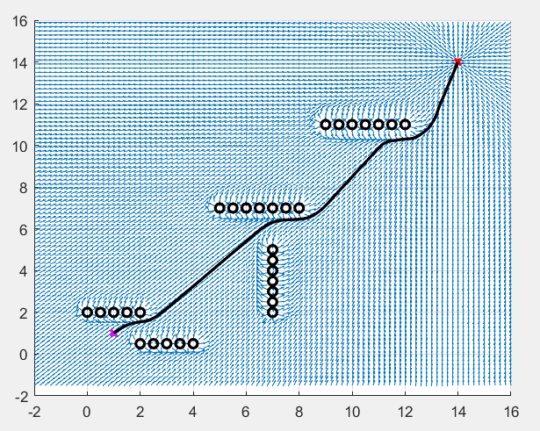
Obtained path

Slide 12
Positioning
Where am I?
Task: locate the robot in a given environment and in a given reference frame.
It is a sensor fusion task involving:
stochastic processes analysis
state prediction/estimation of noise-affected models
topics like covariance, correlation, expected values, probability density functions
Commonly used methods:
Bayesian filters (Kalman filter, Particle filter, ...)
fingerprinting
trilateration

Slide 13
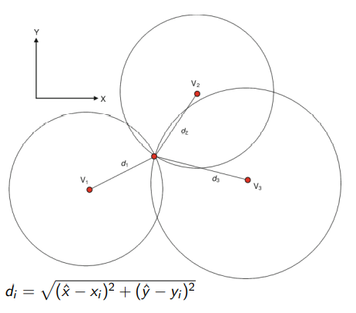
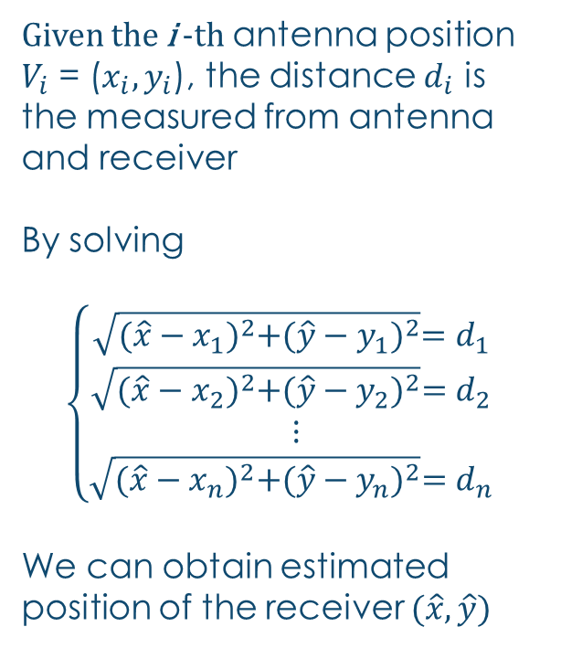
trilateration
Given the i -th antenna position
$V_{i}$ = ($x_{i},y_{i}$), the distance $d_{i}$ is the measured from antenna
and receiver
By solving
$$\left\{\begin{matrix}\sqrt{{(\hat{x}−x_{1})}^{2}+{(\hat{y}−y_{1})}^{2}}=d_{1} \\ \sqrt{{(\hat{x}−x_{2})}^{2}+{(\hat{y}−y_{2})}^{2}}=d_{2} \\ \begin{matrix}⋮ \\ \sqrt{{(\hat{x}−x_{n})}^{2}+{(\hat{y}−y_{n})}^{2}}=d_{n} \end{matrix}\end{matrix}\right.$$
We can obtain estimated position of the receiver $(\hat{x},\hat{y})$

Slide 14
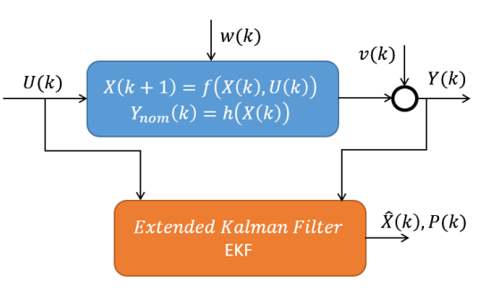
Extended Kalman Filter
It is the most famous extension of Kalman theory to the case of nonlinear estimation.
The main idea is to translate the nonlinear estimation problem into a linear time-varying one

Slide 15
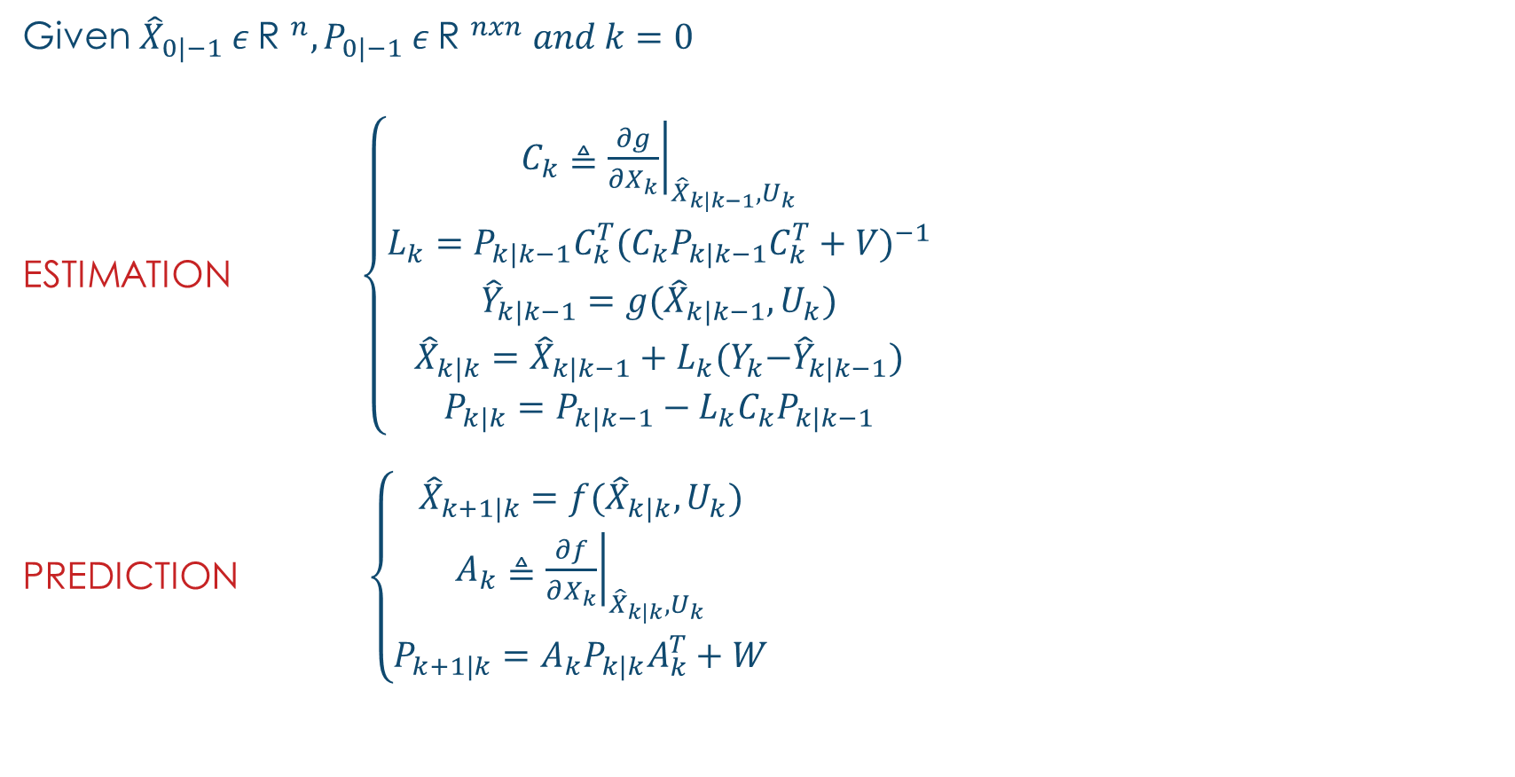
Extended Kalman Filter (EKF)
Given ${\hat{X}}_{0|−1} ε {\text{R} }^{n},P_{0|−1} ε {\text{R} }^{nxn} and k=0$
ESTIMATION $\left\{\begin{aligned}C_{k}≜{\left.\frac{∂g}{∂X_{k}}\right|}_{{\hat{X}}_{k|k−1},U_{k}} \\ L_{k}=P_{k|k−1}C_{k}^{T}{(C_{k}P_{k|k−1}C_{k}^{T}+V)}^{−1} \\ \begin{matrix}{\hat{Y}}_{k|k−1}=g({\hat{X}}_{k|k−1},U_{k}) \\ {\hat{X}}_{k|k}={\hat{X}}_{k|k−1}+L_{k}(Y_{k}{−\hat{Y}}_{k|k−1}) \\ P_{k|k}=P_{k|k−1}−L_{k}C_{k}P_{k|k−1}\end{matrix}\end{aligned}\right.$
PREDICTION $\left\{\begin{aligned}{\hat{X}}_{k+1|k}=f({\hat{X}}_{k|k},U_{k}) \\ A_{k}≜{\left.\frac{∂f}{∂X_{k}}\right|}_{{\hat{X}}_{k|k},U_{k}} \\ P_{k+1|k}=A_{k}P_{k|k}A_{k}^{T}+W\end{aligned}\right.$

Slide 16
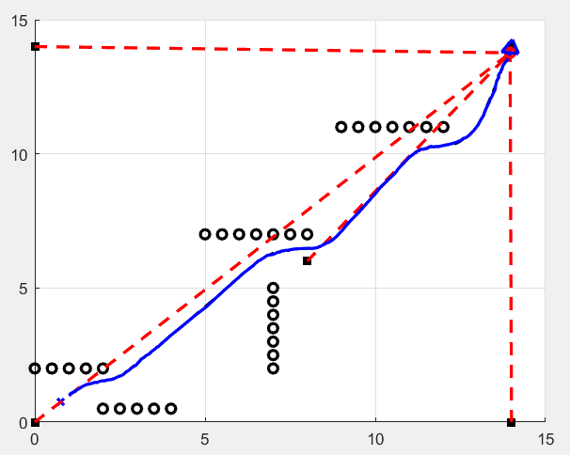
EKF results

Slide 17
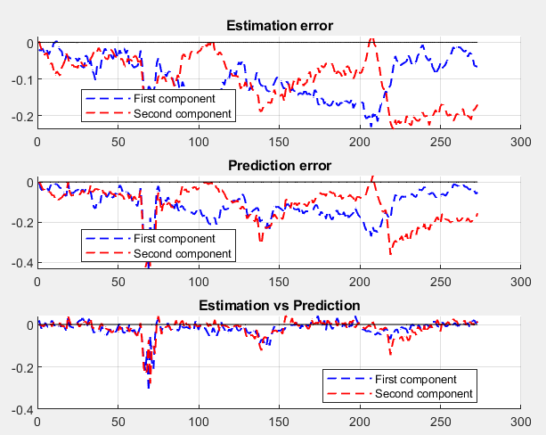
EKF results

Slide 18
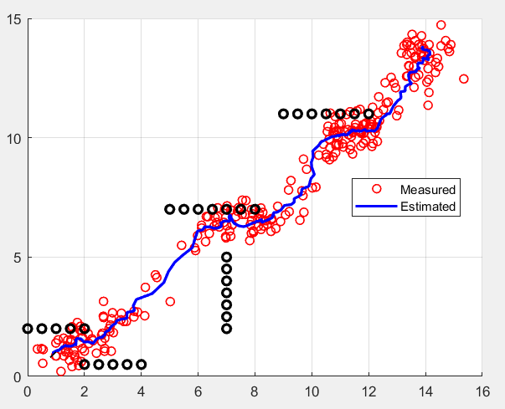
The effect of measurement noise

Slide 19
control
How can I move?
Task: design proper control input for robot in order to reach the desired trajectory or state, considering the current state and environment.
The main challenges:
it is a nonlinear control task
there may be constraints on the admissible robot inputs
especially in a context with moving obstacles, the transient time should be reduced as more as possible
Types of control task:
Trajectory tracking
Posture regulation

Slide 20
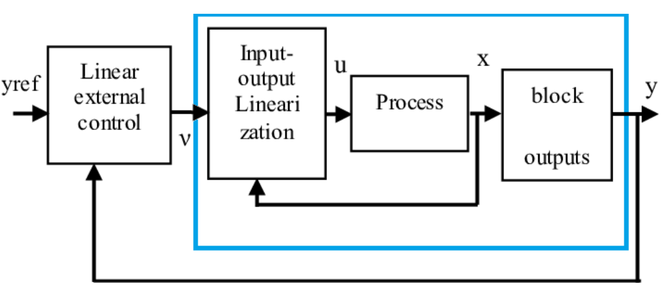
input-output linearization
Input/output linearization via feedback looks for a nonlinear control law based on virtual inputs such that the relationship between these virtual inputs and the system outputs is linear.

Slide 21
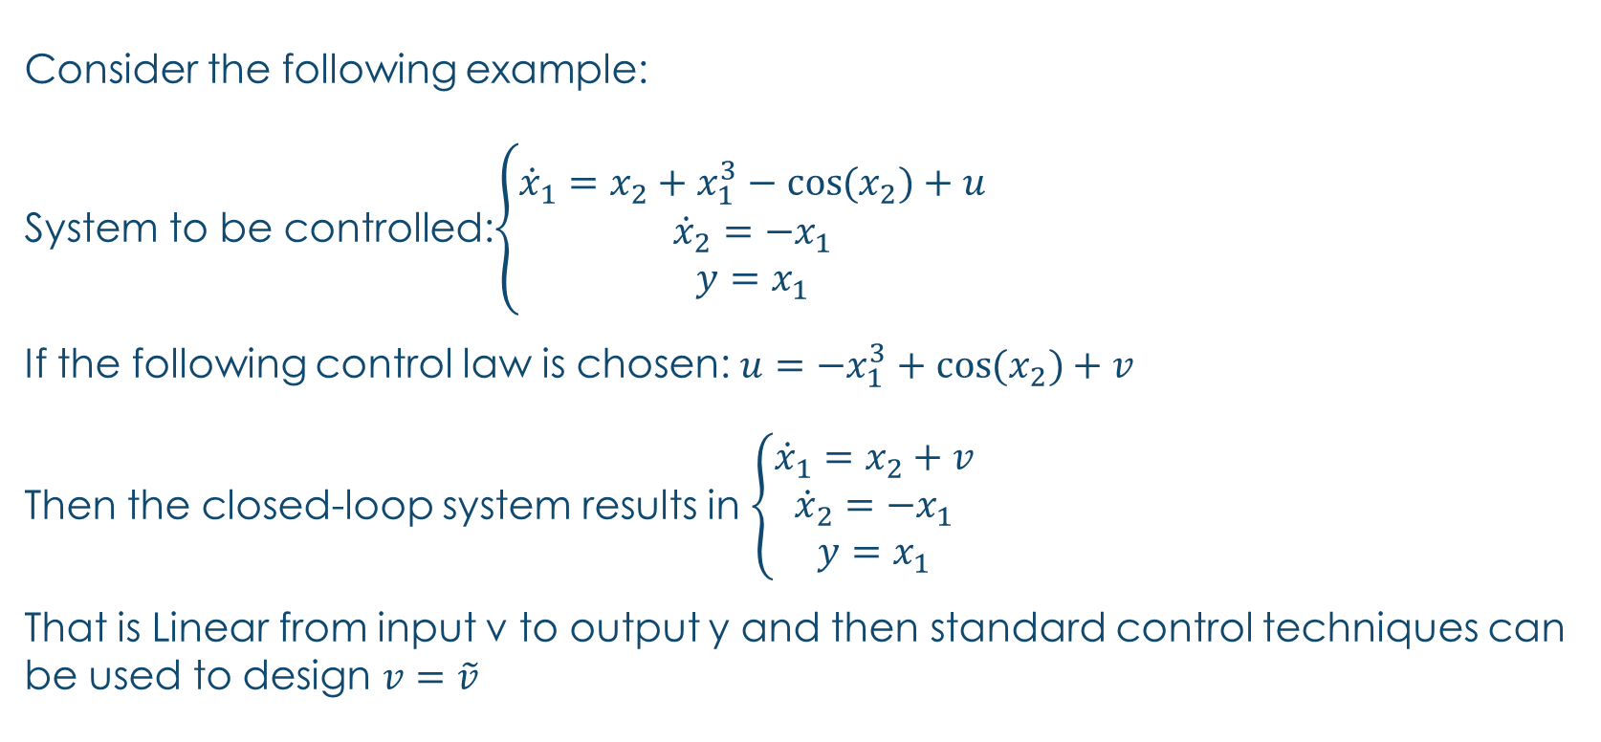
Input-output linearization
Consider the following example:
System to be controlled:$\left\{\begin{matrix}{\dot{x}}_{1}=x_{2}+x_{1}^{3}−\cos{{(x}_{2})+u} \\ {\dot{x}}_{2}=−x_{1} \\ y=x_{1}\end{matrix}\right.$
If the following control law is chosen: $u=−x_{1}^{3}+\cos{{(x}_{2})}+v$
Then the closed-loop system results in $\left\{\begin{matrix}{\dot{x}}_{1}=x_{2}+v \\ {\dot{x}}_{2}=−x_{1} \\ y=x_{1}\end{matrix}\right.$
That is Linear from input v to output y and then standard control techniques can be used to design $v=\tilde{v}$

Slide 22
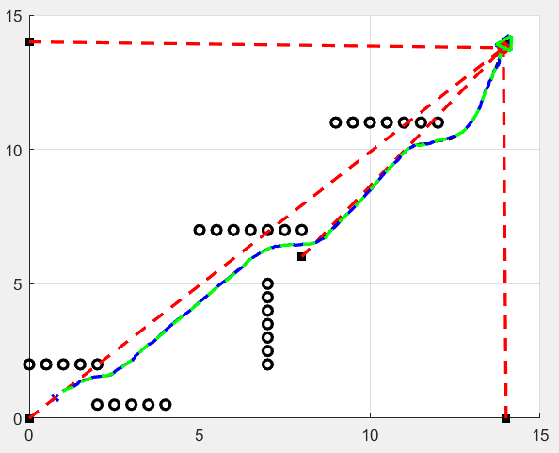
simulation
In this figure blue line is the trajectory made by real robot, dashed green line is estimated state, dashed black line which is aligned with blue line is the reference trajectory, dashed red lines are the distances between robot current pose and beacons. As can be seen from the graph, starting from the start position the robot is able to reach the goal avoiding the obstacles.

